Slide 1

v.0.0.1

Slide 2


[Put your Photo Here]
Welcome! My name is
Loveneesh Dhir
1
I’m here to lead this session & help you learn something new today!
2
I am currently working on ML.
3
I love community building🖤 .
Notes:
What to Edit:
Add your name, photo, school info, and favorite programming tool or language.
What to Do:
Make attendees feel welcome by running a short Ice Breaker.
Go around the room and ask each person to answer the following questions:
Who are you?
What year are you in school and what is your major/field of study?
What is your favorite programming language or tool?
You should go first to demonstrate the exercise and introduce yourself

Slide 3

Our Mission is to Empower Hackers.
65,000+
HACKERS
12,000+
PROJECTS CREATED
3,000+
SCHOOLS
We hope you learn something awesome today!
Find more resources: http://mlh.io/
Notes:
What to Say:
Major League Hacking (MLH) events are meant to bring hackers together so they can learn, build, and share.
Give participants a brief overview of Major League Hacking (MLH).
Tell participants they can learn more at http://mlh.io/
Example Talking Points:
TODO
Through Localhost MLH is rethinking technology education to reflect how hackers actually learn and how fast the industry moves.
Here's some quick facts about MLH:
Each year, MLH supports over 65,000 hackers around the world at events they facilitate
Those students create more than 12,000 amazing projects together
MLH is a global organization that empowers hackers in more than 400 cities and growing every day

Slide 4
What will you learn today?
1
The basics of Git and GitHub
2
The GitHub Workflow
3
Optional: command-line Git usage
Notes:
What to Say:
Explain to participants what they will learn today
Learning is a core part of being a hacker and today they are going to learn something new
What to Do:
Get participants excited about the experience.

Slide 5
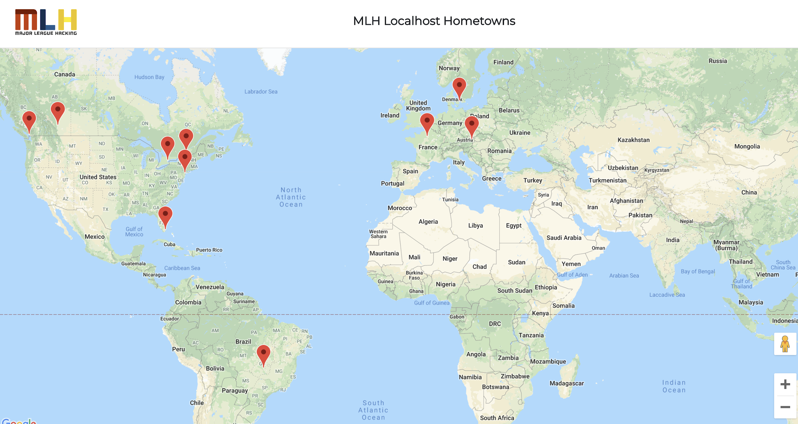
What You'll Be Building
http://mlhlocal.host/github-demo

Slide 6


How Will You Build It?
Make an account on GitHub.
Fork the repo that contains the source code for the website you just looked at.
Add your hometown and make a pull request.
Comment on someone else's pull request.
The workshop organizer will approve and merge pull requests.
Refresh the main website to see people being added!

Slide 7
Now that you understand how it works, let's get started!

Slide 9
We're all going to collaborate on a project together. How? Version control!

Slide 10


Git vs. GitHub
What's the difference?
Git
GitHub
Git is a version control system.
It can be used with various tools or locally on your computer to help you keep track of changes in your code projects.
Think of it like Google Docs for code, but better.
GitHub is a platform for code collaboration!
GitHub uses Git for version control and provides you all sorts of awesome collaboration tools.

Slide 11
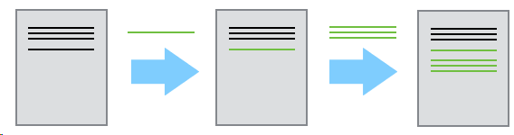
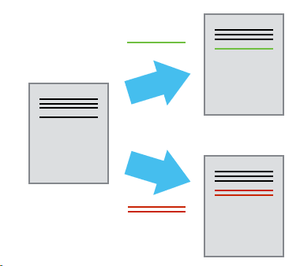
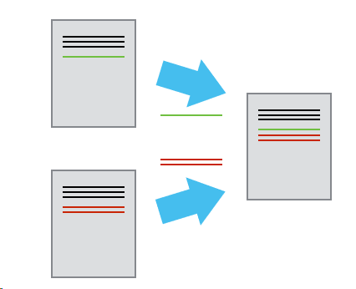
Why version control?
Because emailing a file around is painful
Version control features:
Log changes in a searchable way, instead of renaming a file for each version.
Collaborators can work in parallel and merge their changes automatically, instead of manually comparing the differences between a file
Graphics taken from the Software Carpentry Git Lesson*
Notes:
Git is a Version Control System. It’s a tool to solve the problem of collaborating with multiple people. It works well if you’re collaborating on one file or a million files. Scalability!

Slide 12
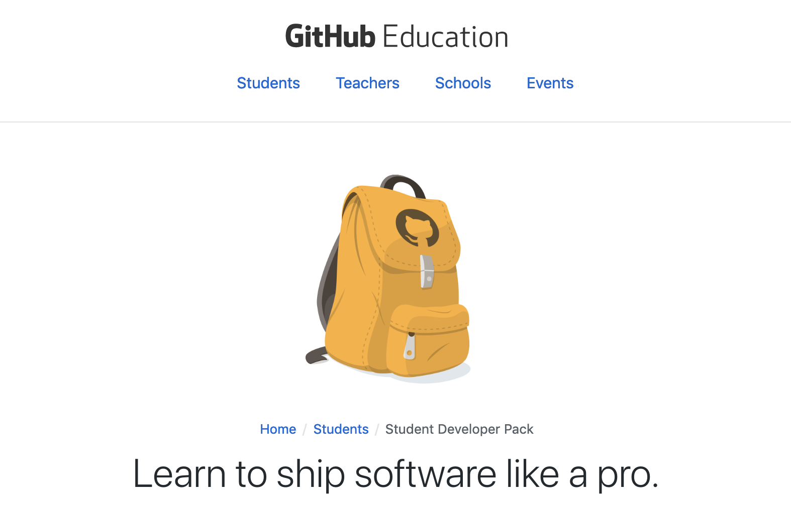
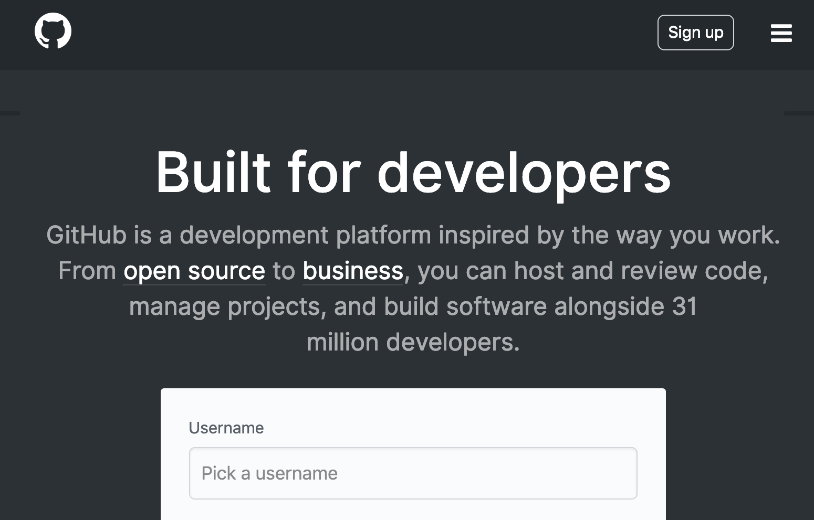
Let's make an account!
Visit the URL on the left if you're a student and on the right if you are not. Follow the instructions on GitHub.com to make your account!
http://mlhlocal.host/github-edu
http://mlhlocal.host/github-signup

Slide 13
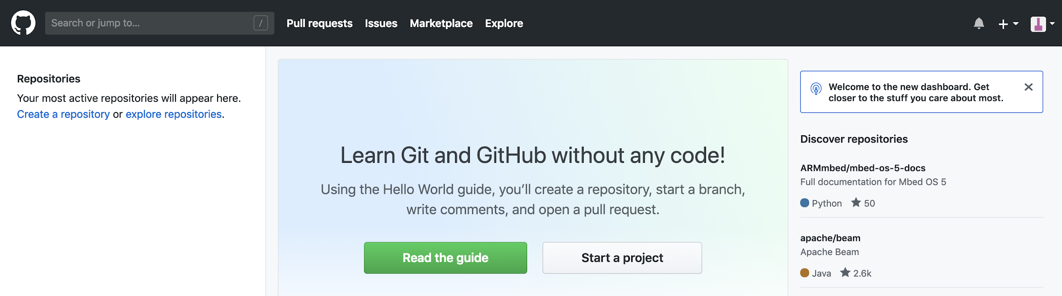
Explore GitHub
The GitHub platform provides numerous features for collaboration.
Next to the search bar, you can select Pull requests. This will show you your own pull requests against other people's repos.
Key Term
pull request: a way to ask to make changes to someone else's code by submitting your own changes for their review

Slide 14
Explore GitHub
The GitHub platform provides numerous features for collaboration.
Next to pull requests, you can see any issues you've opened or worked on.
Key Term
issues: a way to share a problem about someone else's code, without necessarily submitting your own solution

Slide 15
Explore GitHub
The GitHub platform provides numerous features for collaboration.
In the upper right hand corner, you can see any notifications you have received.
The + symbol allows you to create a new project.
Clicking your avatar opens the settings menu.

Slide 16
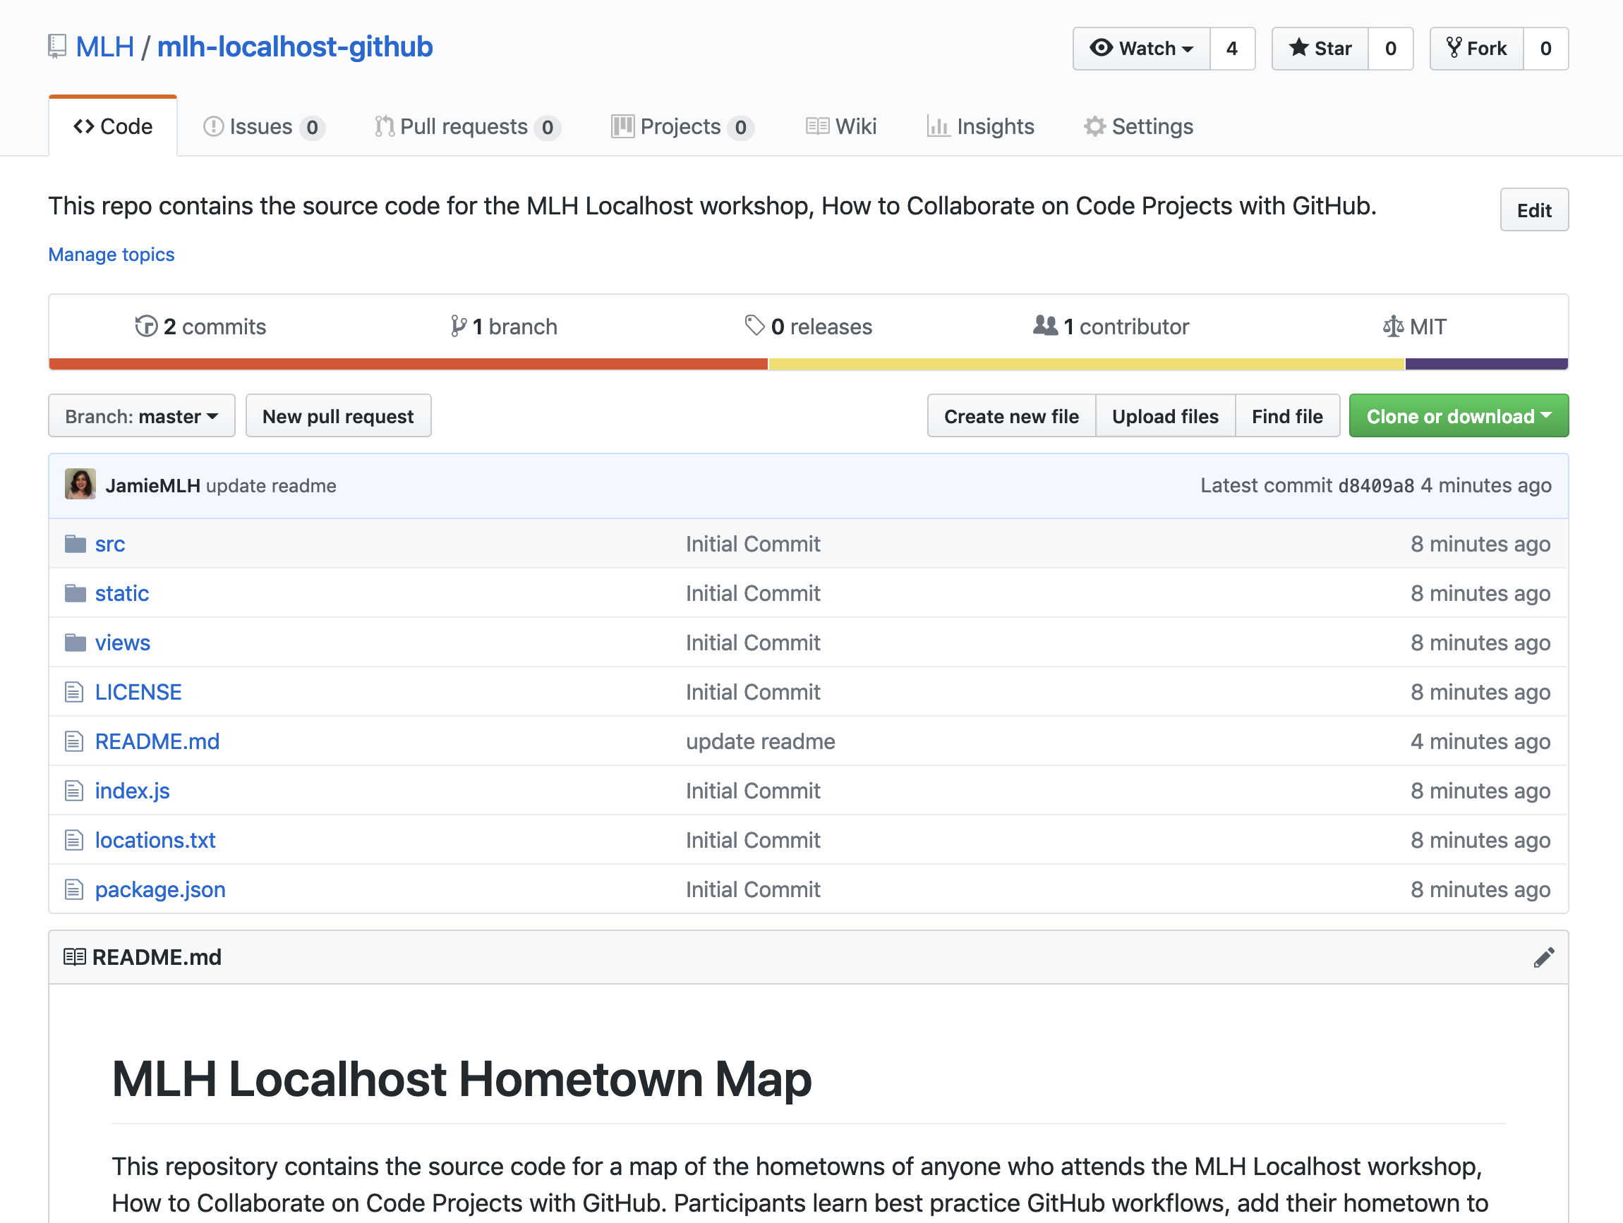
Explore a Repository
Navigate to the URL below and let's check out the repository for the map!
http://mlhlocal.host/github-code
Key Term
repository: think of this like a project folder where code is stored!

Slide 17
Explore a Repository
The first tab in a repository is the Code tab. It shows the code in the project.

Slide 18
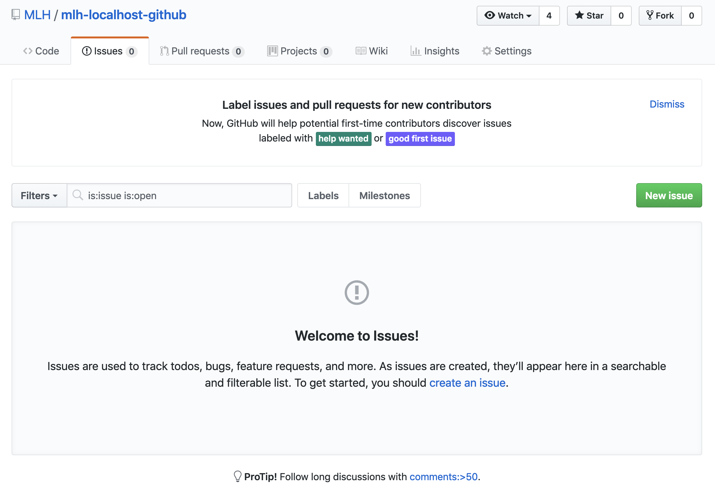
Explore a Repository
The second tab is the Issues tab. If there is a problem with the code in someone's project, you can open an Issue and let them know about it. Pro-tip: You should always follow the project maintainer's instructions for opening an issue.

Slide 19
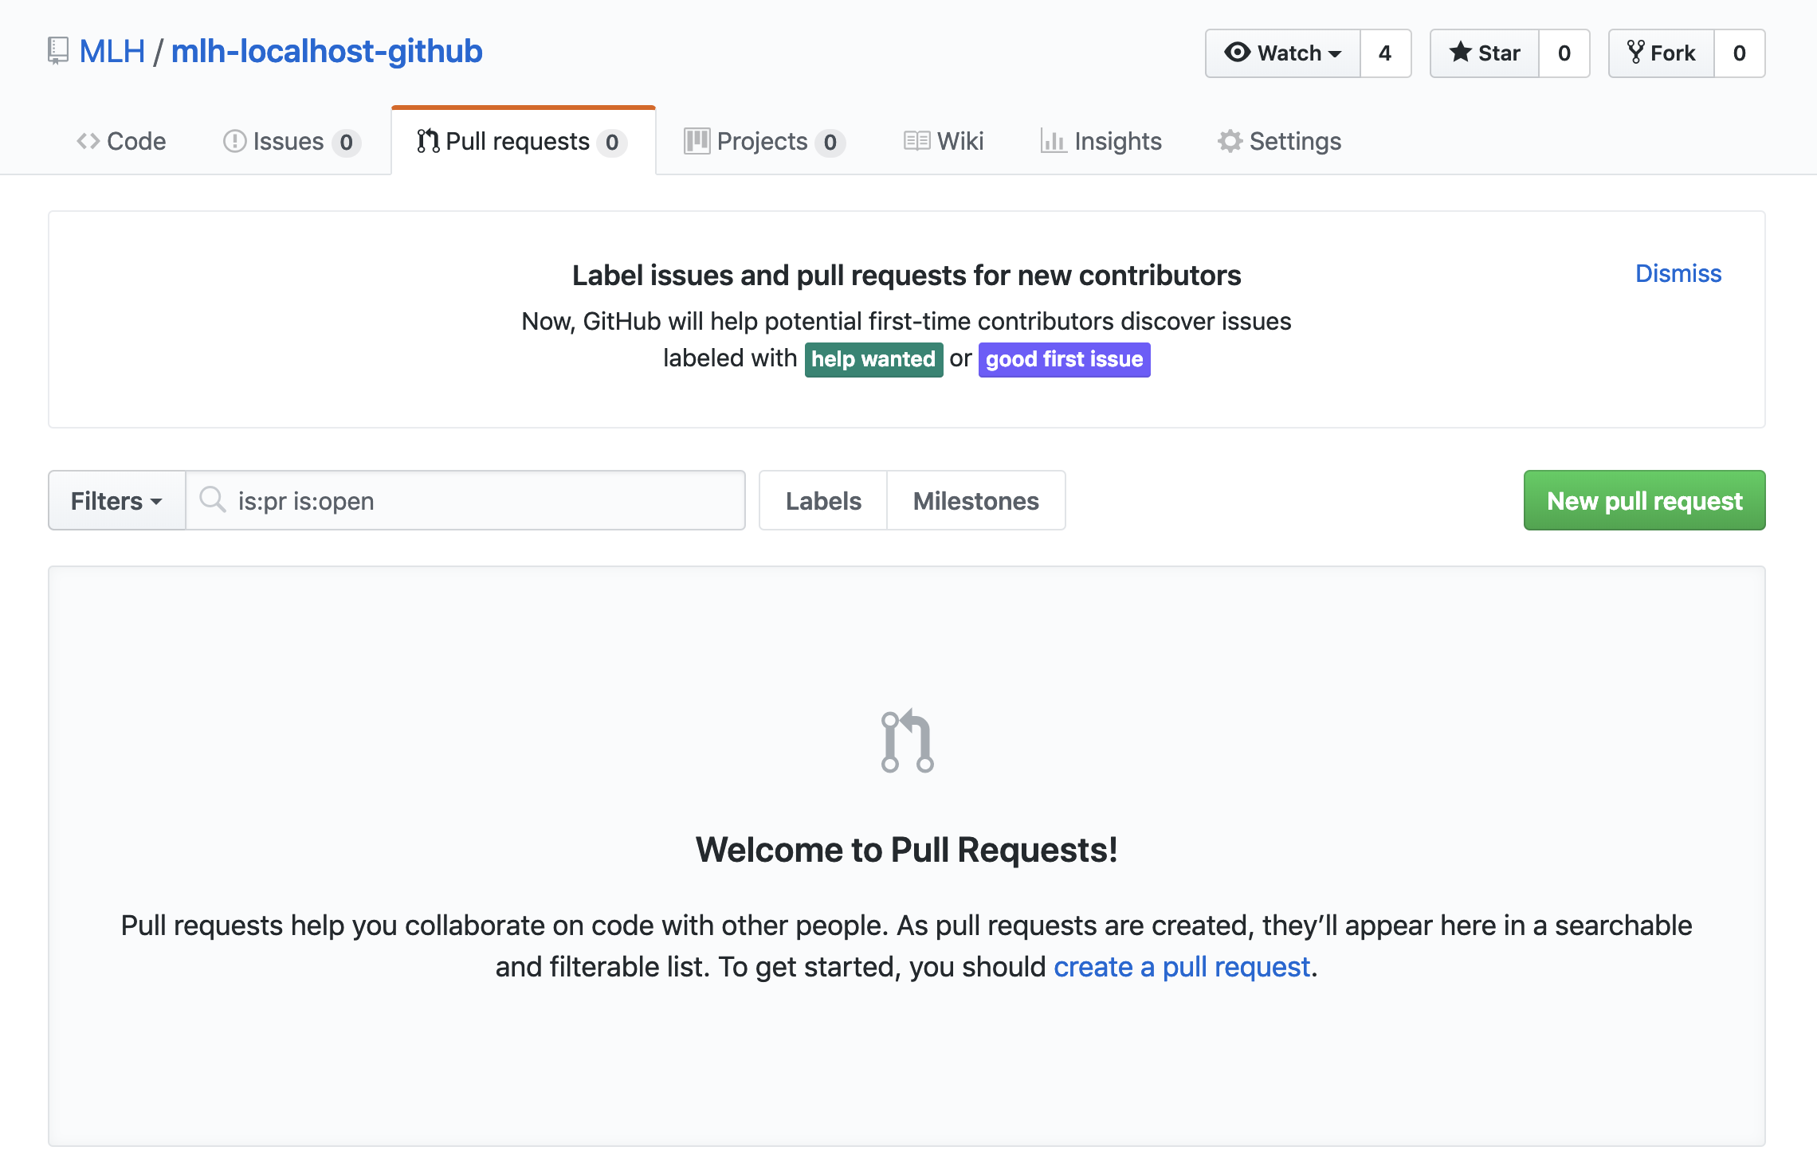
Explore a Repository
The third tab is the Pull Requests tab. If you want to contribute code to someone's repository, you'll open a Pull Request. You'll do that today!

Slide 20
There is a lot of terminology regarding Git and GitHub. Let's get started!

Slide 22
Developer Workflow
You're going to practice a typical best practice developer workflow.
First, you'll fork someone else's code. This means creating your own copy of it.
Then you'll create a branch. The branch is a parallel version of your copy, where you'll test your own changes.
Key Terms
fork: your own copy of someone else's repository.
branch: a parallel version of the master copy of a repo. Making a branch allows you to edit code without accidentally breaking a working version

Slide 23
Developer Workflow
You stage your changes as you go. When you're happy with them, you'll commit them.
If you want to add your code to someone else's project, you'll open a pull request.
If they approve it, they'll merge your branch into their master branch.
Key Terms
stage: add to a cohesive group/bundle of revisions
commit: a group of revisions you want to officially add to your branch
merge: to officially add the changes from your branch into the master branch (or another branch)

Slide 24
Great! That's it. That's how you work with Git. Let's try it using GitHub!

Slide 25


THANK YOU

Slide 26
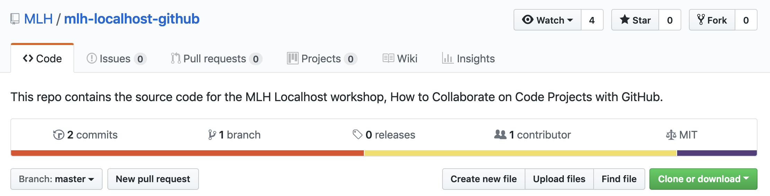
Network Activity Workflow
As you can see, there are so many way to use GitHub! Today we're going to use a very common developer workflow.
Fork the repository you want to contribute to.
Note: This is only necessary if you are not a Collaborator on the project.

Slide 27
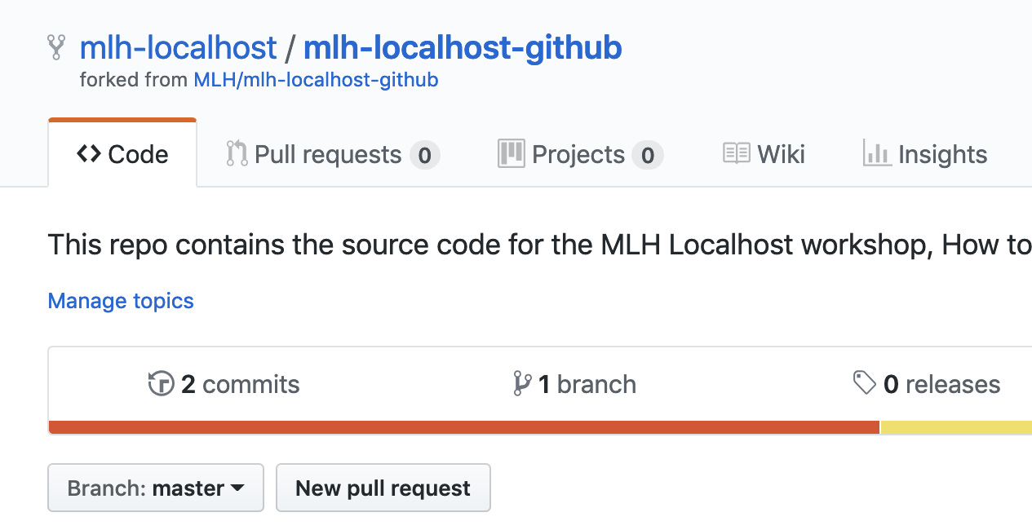
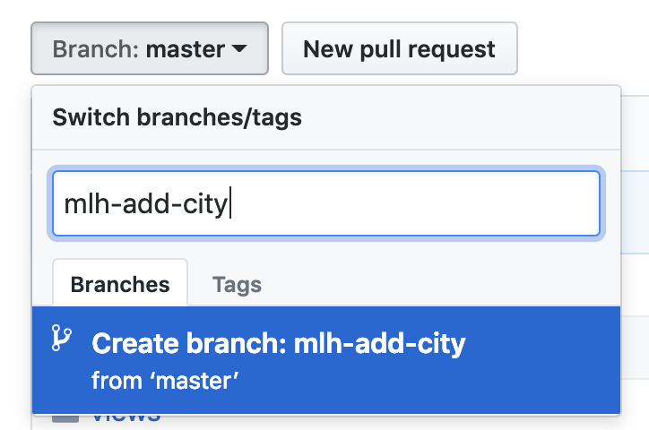
Network Activity Workflow
Create a branch. You should always try to name branches with your name and what you're doing, or follow the conventions set by your team.

Slide 28
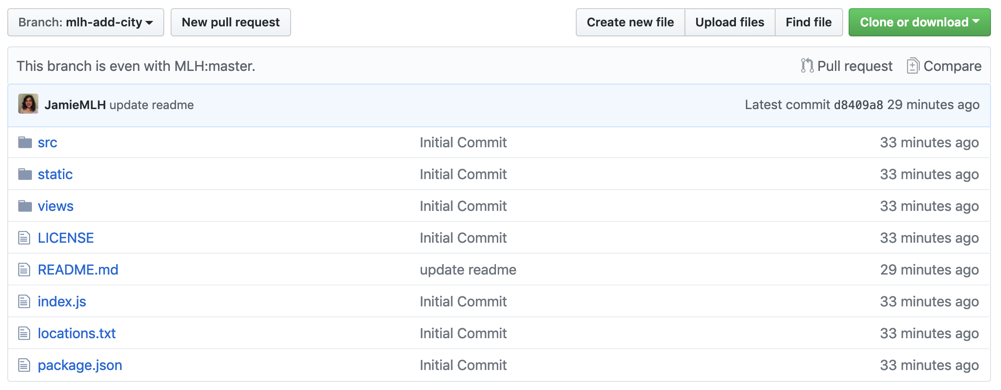
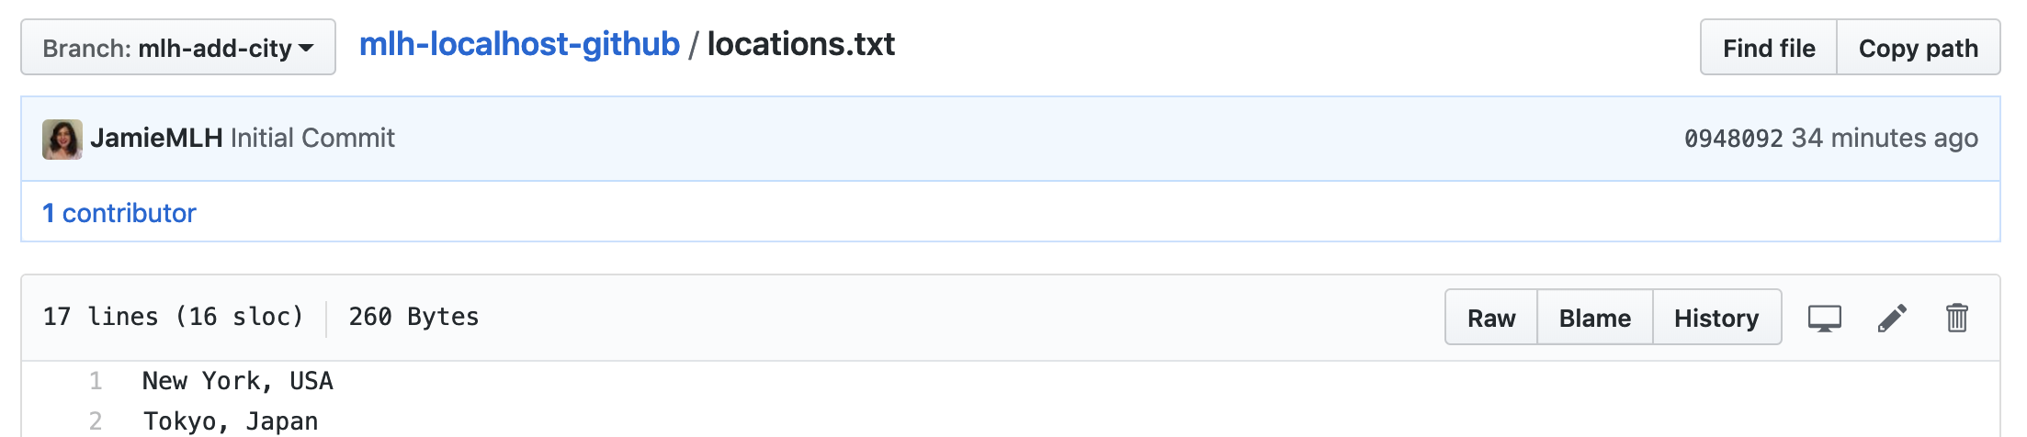
Developer Workflow
Open locations.txt.
Select the edit icon. It looks like a pencil.

Slide 29
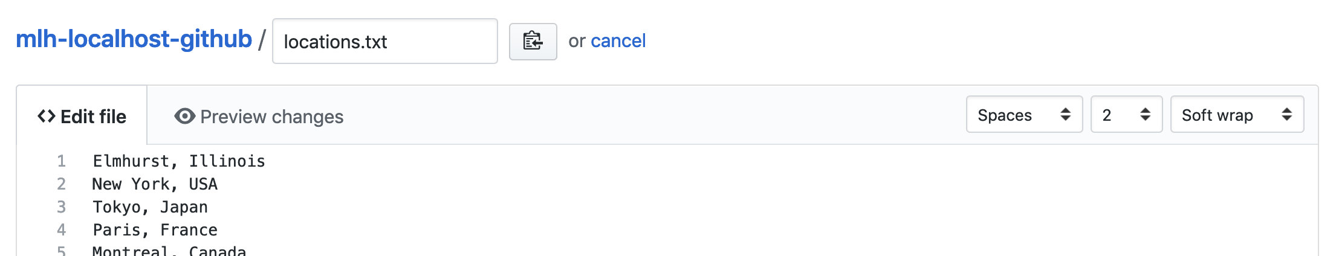
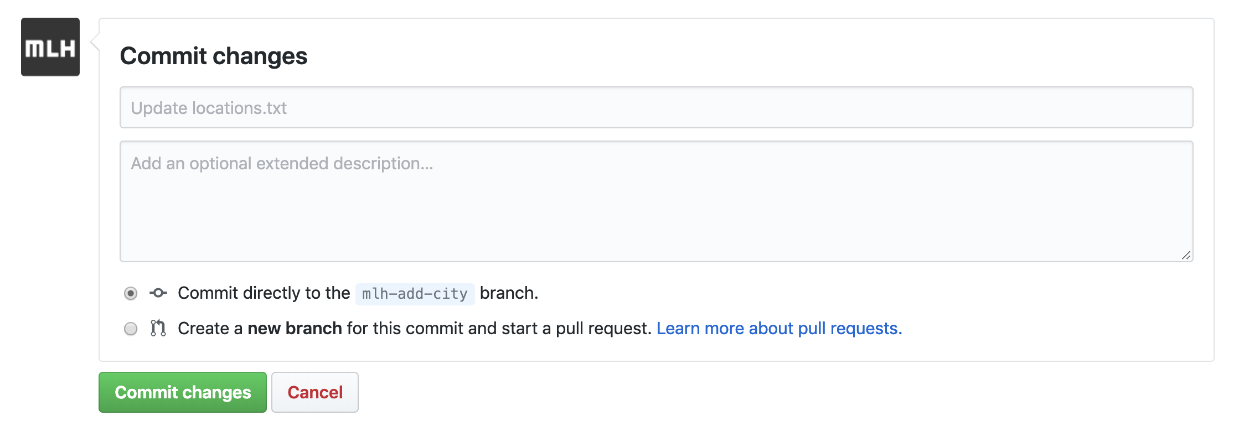
Network Activity Workflow
Add the name of your hometown. Choose a random blank line!
Scroll to the bottom to the Commit changes section.

Slide 30
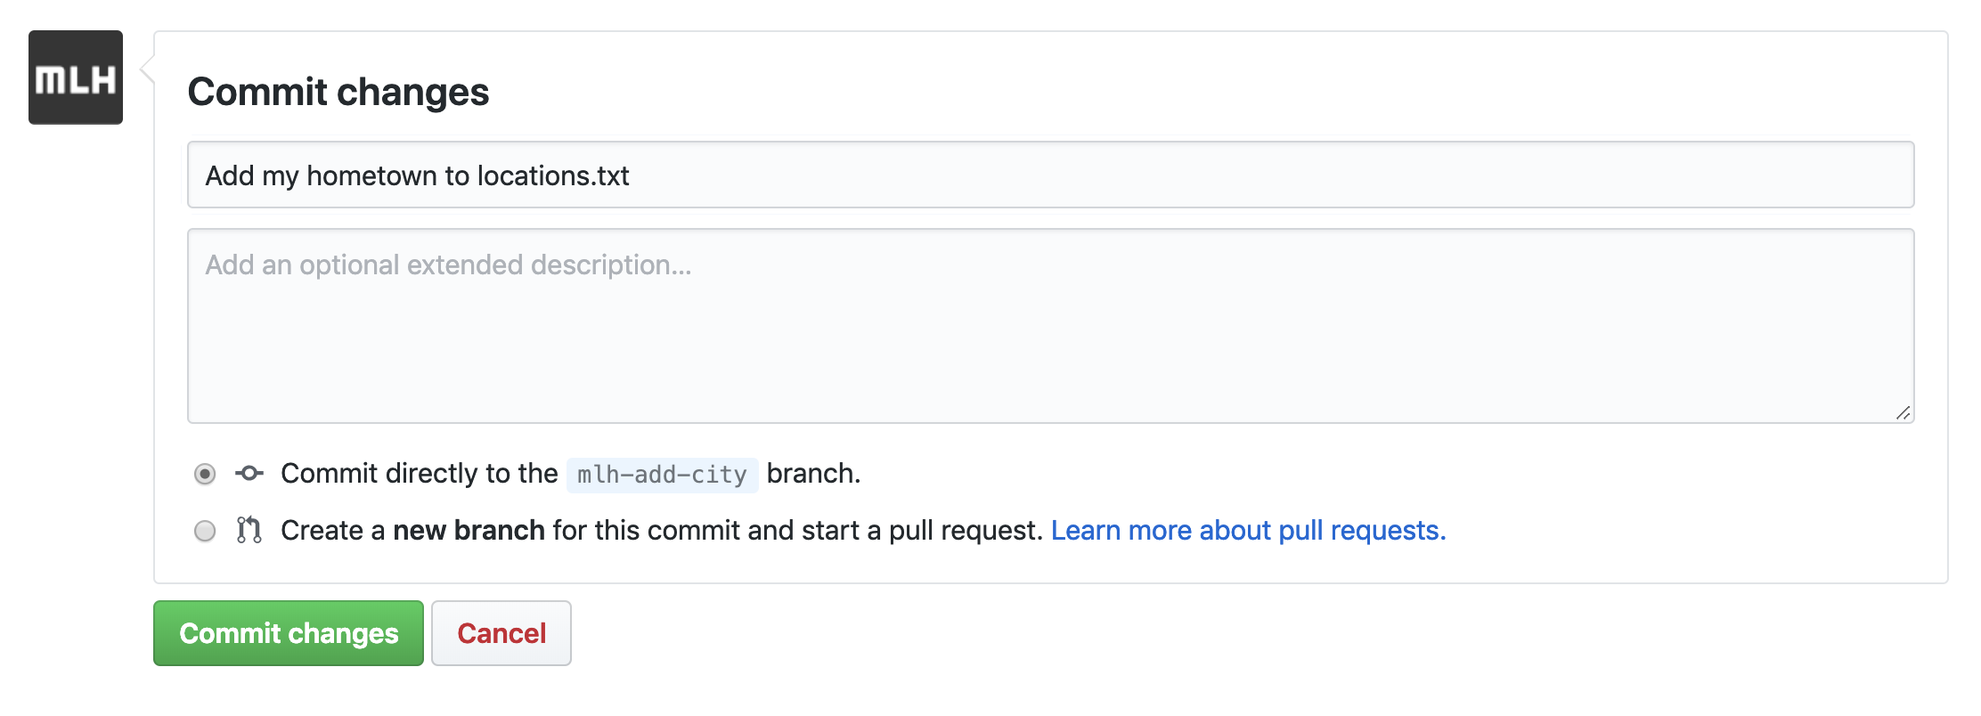
Network Activity Workflow
Add a descriptive message. Select Commit changes.

Slide 31
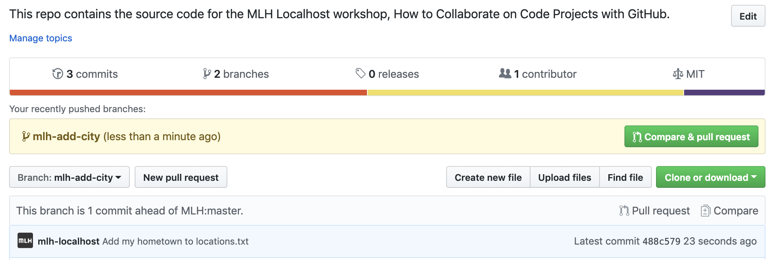
Network Activity Workflow
Return to the main page of your repo.
Select Pull request.

Slide 32
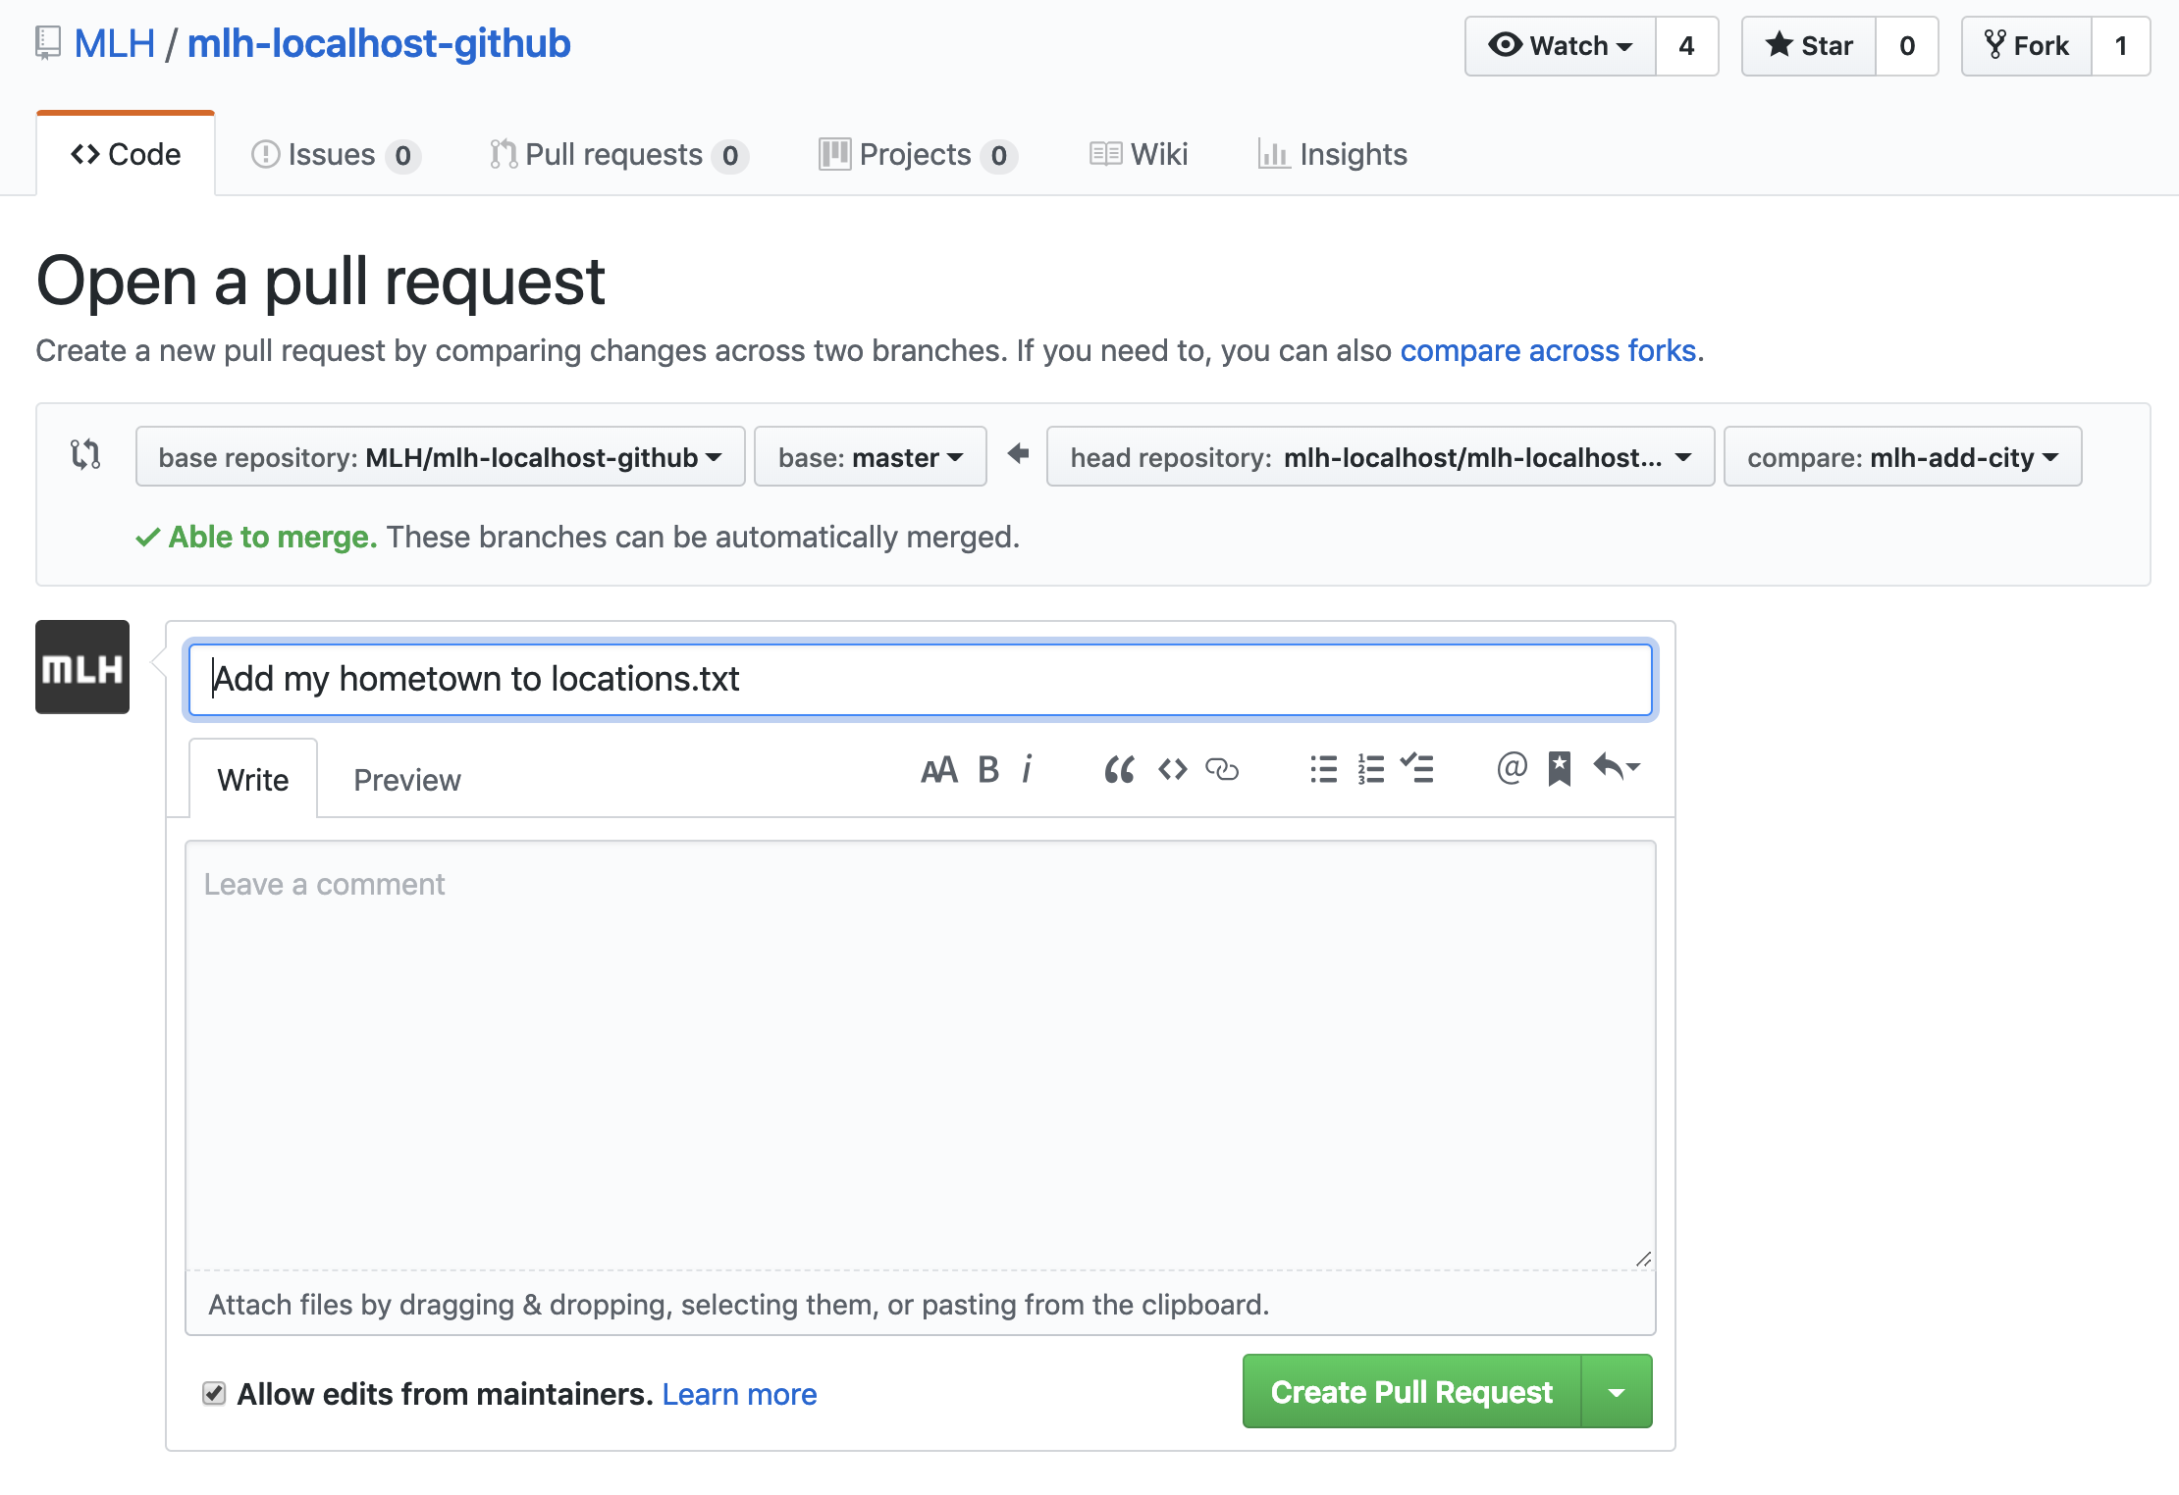
Network Activity Workflow
Because this is a simple pull request, you can simply select Create Pull Request. If you were contributing to an open source project, you would want to be very descriptive about the changes you made.

Slide 33
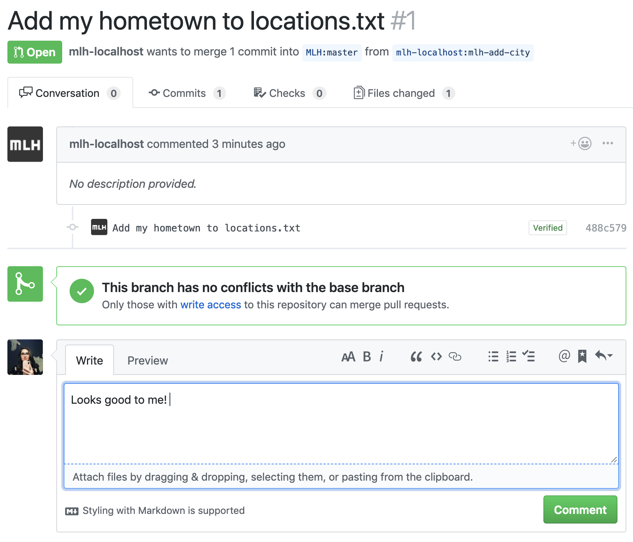
Network Activity Workflow
Ask someone else to comment on your PR. Comment on someone else's PR, too! You can find other pull requests by selecting the Pull requests tab on the repo's home page.

Slide 34
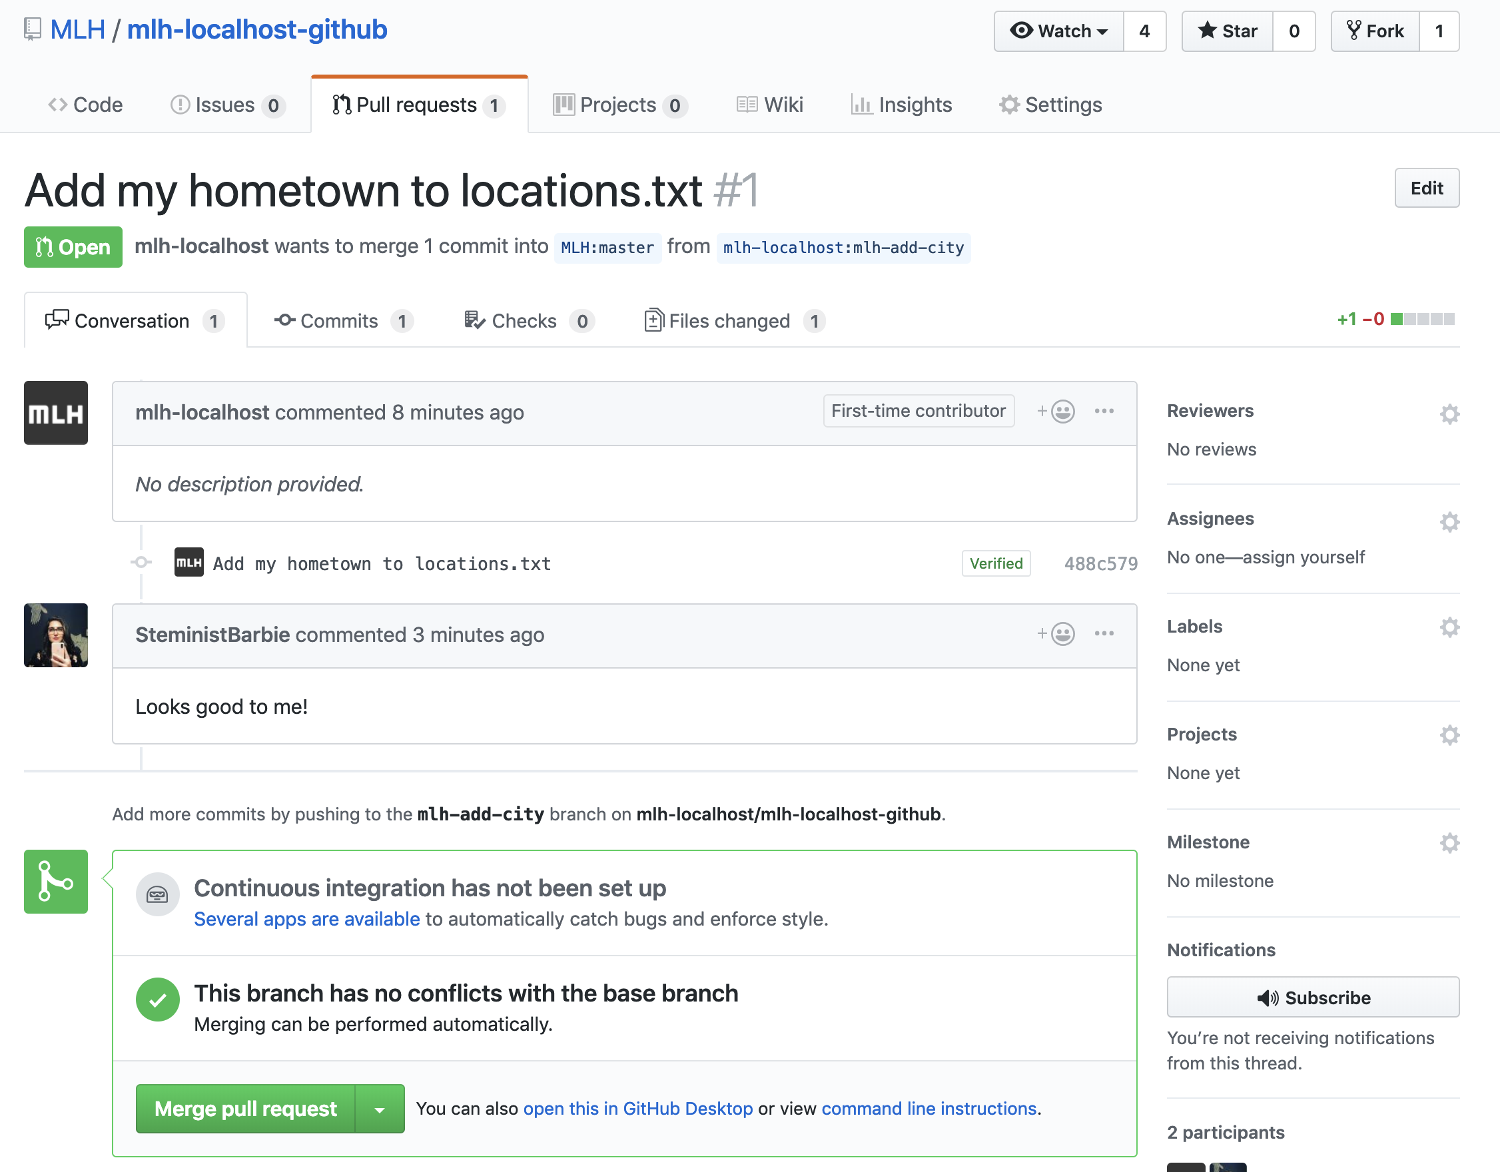
Network Activity Workflow
This is what a pull request looks like for someone who has Write access to a repo. The organizer of this workshop will click Merge pull request, and your hometown will be added!

Slide 35
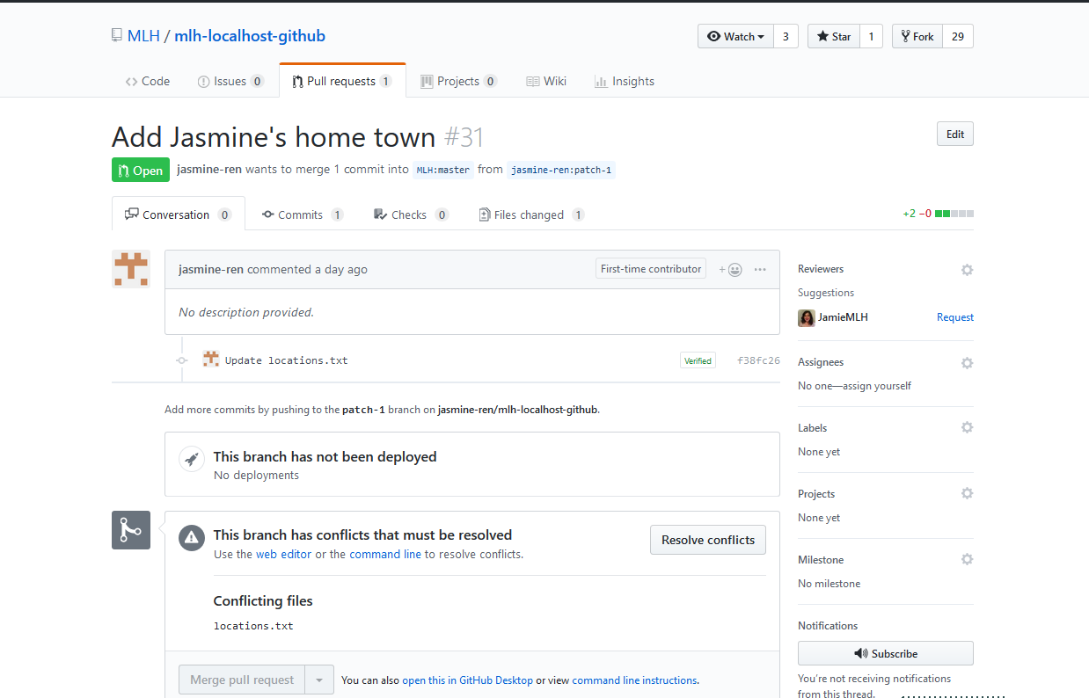
Conflict Resolution
When a file has multiple edits, it can be unclear which change should be committed. This is a conflict and must be resolved before merging.

Slide 36
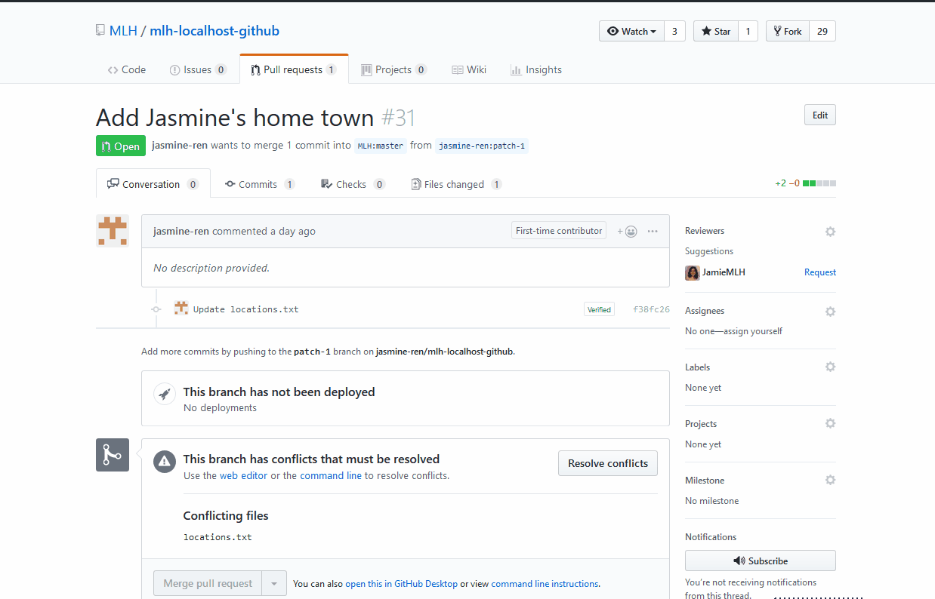
Conflict Resolution
A conflict is marked by
<<<<<<< new branch
changes
=======
original >>>>>>> original-branch
Edit the file to the desired state, mark it resolved and then merge it.
Notes:
In the gif, there is no text being replaced, so there’s no “original”.
You can ask for a volunteer to come up and help resolve conflicts. This might also be a good time to take break so you can resolve all the conflicts.

Slide 37
Network Activity Workflow
Refresh the original webpage and wait for more people's hometowns to be added! Note: this web site is set up to auto-deploy when new code is merged to the repository, but it can take a few minutes.

Slide 38
Amazing! Now you know how to work with GitHub in the browser. The next section will teach you how to use GitHub on the command line on your computer!

Slide 40
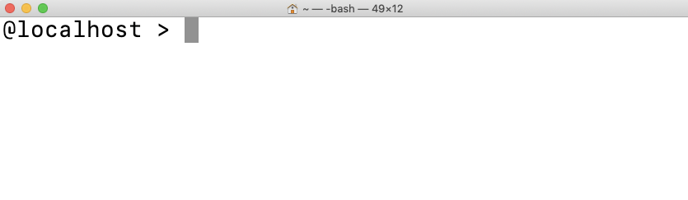
GitHub From the Command Line
Once you start working on projects that are more complex, you might find that you prefer using your own local coding environment with GitHub. Let's learn how to set that up! We'll also learn how our local environment works with our repos on GitHub.

Slide 41
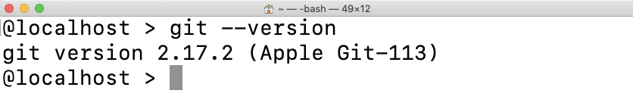
Install Git
First, let's see if you have Git already installed on your computer. Type the command below in Terminal, PowerShell, or any terminal application. If you already have git installed, you can skip the next few slides!

Slide 42
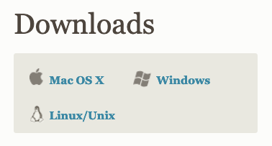
Install Git
http://mlhlocal.host/install-git
If you do not have git installed, navigate to the URL above.
Select your operating system and the installer will download.

Slide 43
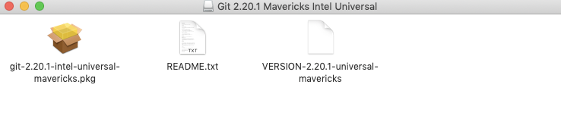
Install Git: MacOS
Open the installer and follow the instructions. It should be fine to select all of the default options.

Slide 44
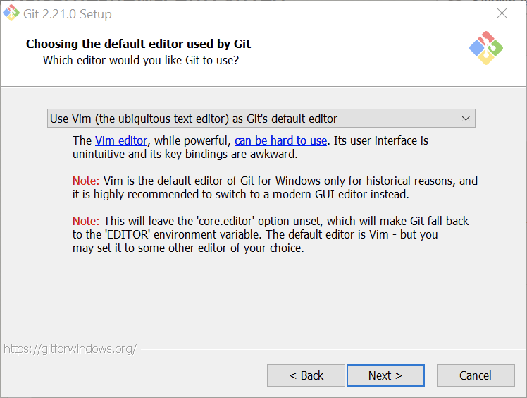
Install Git: Windows
Open the installer and follow the instructions. It should be fine to select all of the default options, except for the one below. We recommend choosing your preferred text editor in this step.

Slide 45
Install Git
Restart your terminal, PowerShell, or Git Bash.
Run the command below again. Raise your hand if this is not what you see.

Slide 46
Great! Now you have Git installed. Let's connect your local environment with your GitHub account.

Slide 47
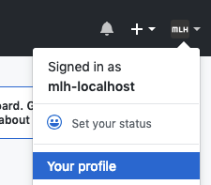
Configure Git
We want to configure our local environments so that the correct GitHub account is associated with our commits.
On GitHub, find your user name. You can find it by clicking your avatar in the upper right hand corner. It will say "Signed in as"

Slide 48
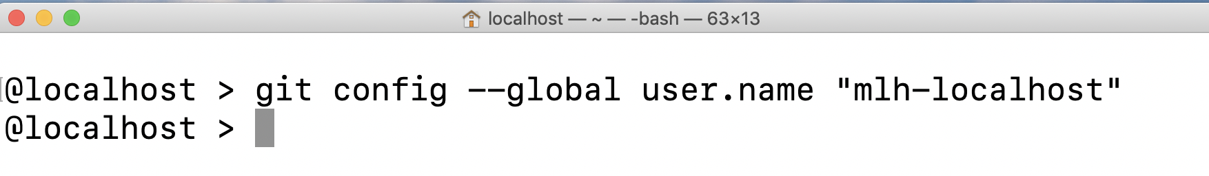
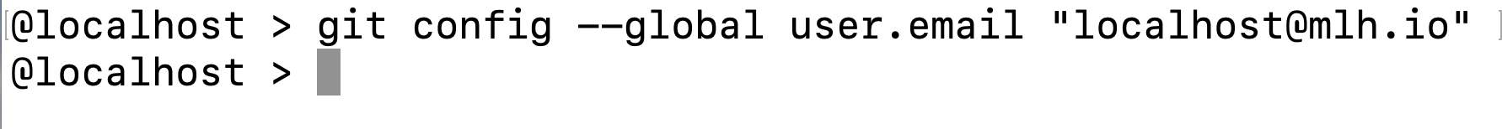
Configure Git
Return to your command line or terminal. Replace mlh-localhost with your username.
Use the command below to configure your email address as well.

Slide 49
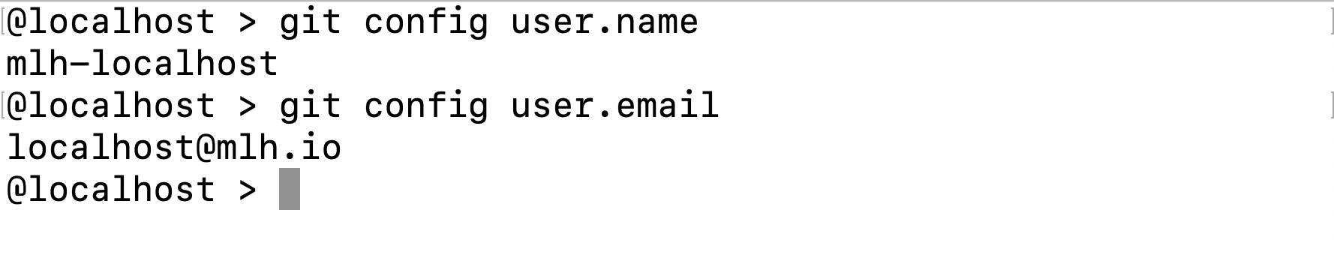
Configure Git
You can use the two commands below to double check that you've set this up.

Slide 50
Now, let's cover some useful commands.

Slide 51
Individual Workflow
The workflow from the command line has a few added steps compared to using GitHub.
You can clone any repository you have access to using git clone.
Then, you create a branch with git branch "name-of-branch".
After you make changes, you'll use git add to stage your changes.
Key Terms
clone: to copy a repository to your computer
stage: saving your changes so they are ready to be added to your branch
Notes:
GitHub combines some commands to make things less confusing.
Git is really complicated. It takes years to learn completely. However, you can be competent enough to Get Things Done with a few commands.

Slide 52
Individual Workflow
The workflow from the command line has a few added steps compared to using GitHub.
You'll use git commit -m "explain your changes" to add changes to your branch.
When you're ready to push your local changes to your repository on GitHub, you'll use git push.
Command Explanation
-m is a flag for message. That means that whatever comes after -m is a message explaining your commit. Your commit message doesn't have any effect on your code; it's like a comment.
Key Terms
push: add the changes on your computer to your GitHub repository.
Notes:
GitHub combines some commands to make things less confusing.
Git is really complicated. It takes years to learn completely. However, you can be competent enough to Get Things Done with a few commands.

Slide 53
Individual Workflow
The workflow from the command line has a few added steps compared to using GitHub.
You can make a pull request and have your PR merged on GitHub like before.
You can pull changes from GitHub to your local repository.
Key Terms
pull: Bring changes from GitHub down to your local copy.
Notes:
GitHub combines some commands to make things less confusing.
Git is really complicated. It takes years to learn completely. However, you can be competent enough to Get Things Done with a few commands.

Slide 54
You might feel a little confused by committing, staging, and pushing your changes. Let's explore a visual representation!

Slide 55

Three phases of Git
There are three main phases of Git. You can think of these like a work desk!
Working directory
Where the writing happens. This is when you are coding and saving your work.
Staging area
When you are happy with a group of changes and use git add, you are staging your changes. These are like called commits, and they are like rough drafts stored in a bundle.
Repository
When you are happy with your commits, you commit them to the repository. These are like final drafts stored more permanently in a drawer
Notes:
The three phases of git can be thought of as a typical desk setup. You move from writing without version control, to making a bundle of changes and then permanently storing those changes in a repository.

Slide 56
Here's another visual representation of what you just saw.

Slide 57



Three phases of Git
Use the staging area to build a commit
Repository Final draft, permanent
git commit
Staging Area Your rough draft
git add
Working Directory Your workspace, local on your machine
Notes:
The commands, git add and git commit are how changes moves between stages.

Slide 58
Great! Let's try it.

Slide 59
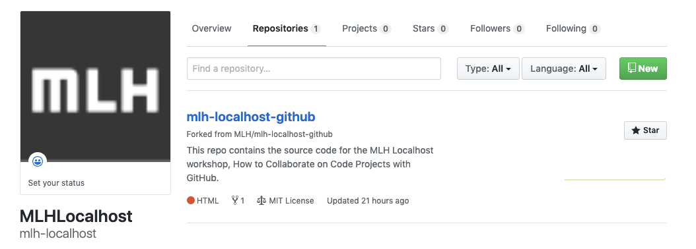
Create a Repo
Let's create a new repository on GitHub and work with it locally.
From your profile or homepage on GitHub, click New.

Slide 60
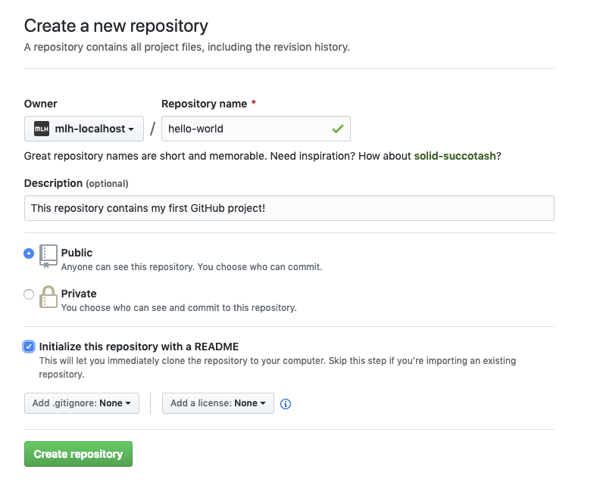
Create a Repo
Name your repository (repo) whatever you want! We chose hello-world.
Write a sentence describing your repo.
Select Initialize this repository with a README.

Slide 61
Create a Repo
If this were a code project, you would usually add a .gitignore and/or a license but you don't need to.
Click Create repository.

Slide 62
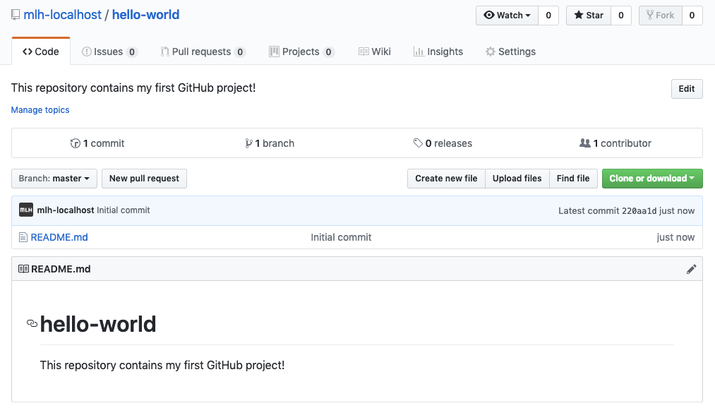
Create a Repo
You will be redirected to the homepage for your new repository!

Slide 63
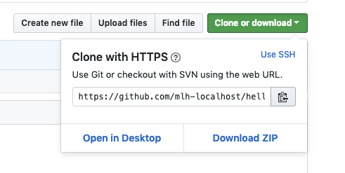
Clone Your Repo
Click Clone or download.
Then click the clipboard symbol to copy the address of your repo.

Slide 64
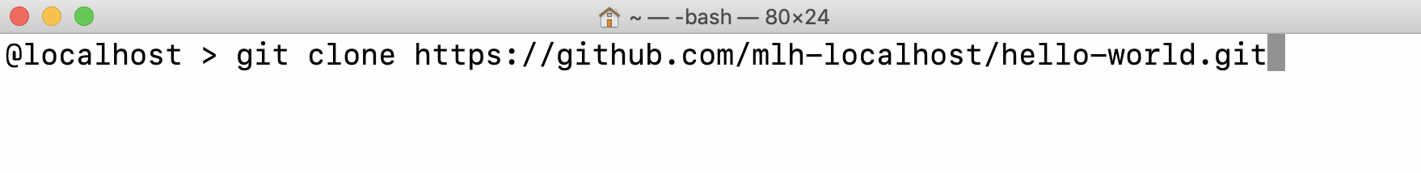
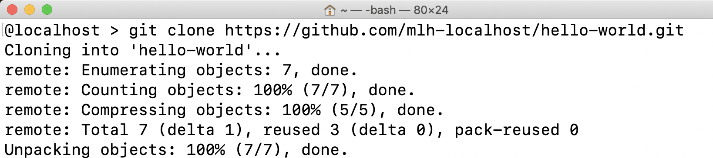
Clone Your Repo
Back in the terminal, type git clone then paste the address of your repo.
You will see output like this:

Slide 65
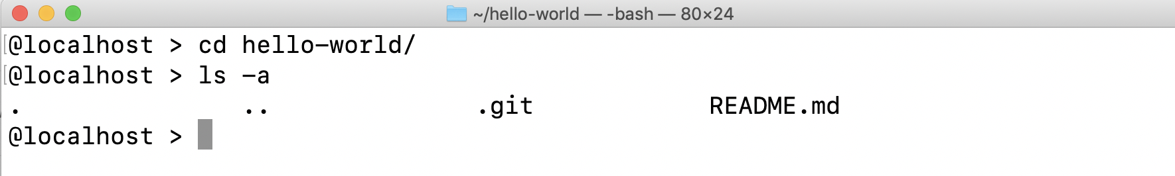
Explore Your Repo
It's important to note that you did not simply download the code. You cloned a Git repo. A git repo comes with a special folder called .git. You don't need to know a lot about this folder. Just keep in mind that it connects your local project to the project on GitHub.

Slide 66
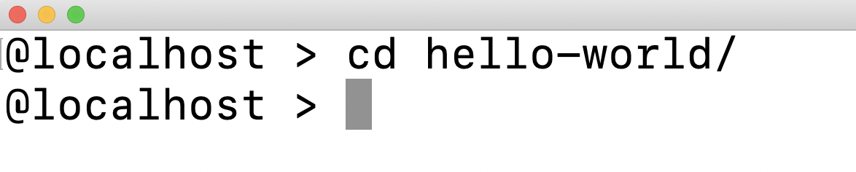
Let's make a change!
Change directory into the repo you cloned by typing the command below.
Note: If you did not name your repo hello-world, you should substitute hello-world with the name of your repo.

Slide 67
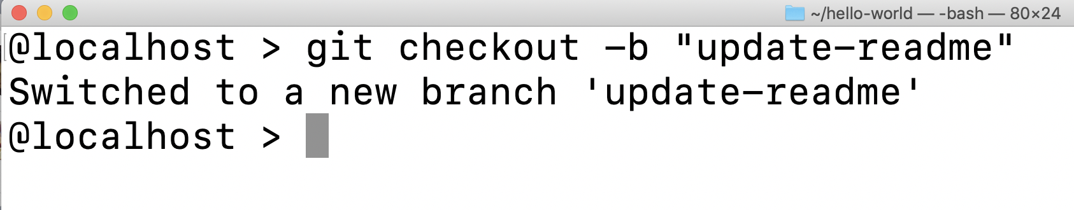
Let's make a change!
We're going to make some changes. You never want to commit directly to master, so let's checkout a new branch. You did this in the browser before. Use the command below to create a new branch.

Slide 68
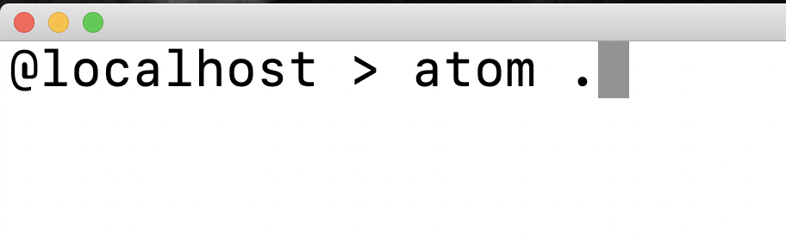
Let's make a change!
Open your project folder in the code editor of your choice. For example, if you have Atom installed, you can use the command below to open the project in Atom.

Slide 69
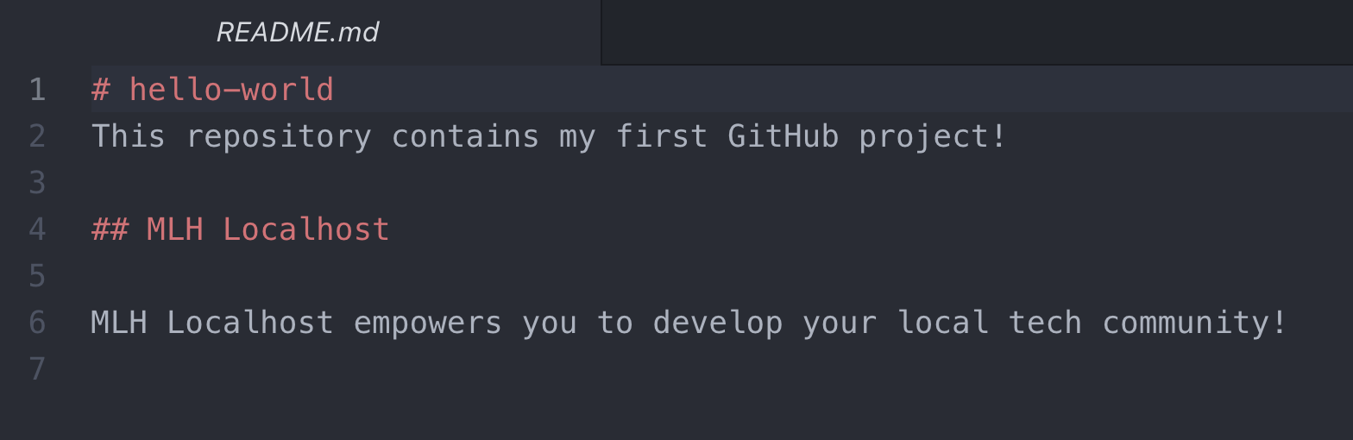
Let's make a change!
Make any changes you want to your README and save them.

Slide 70
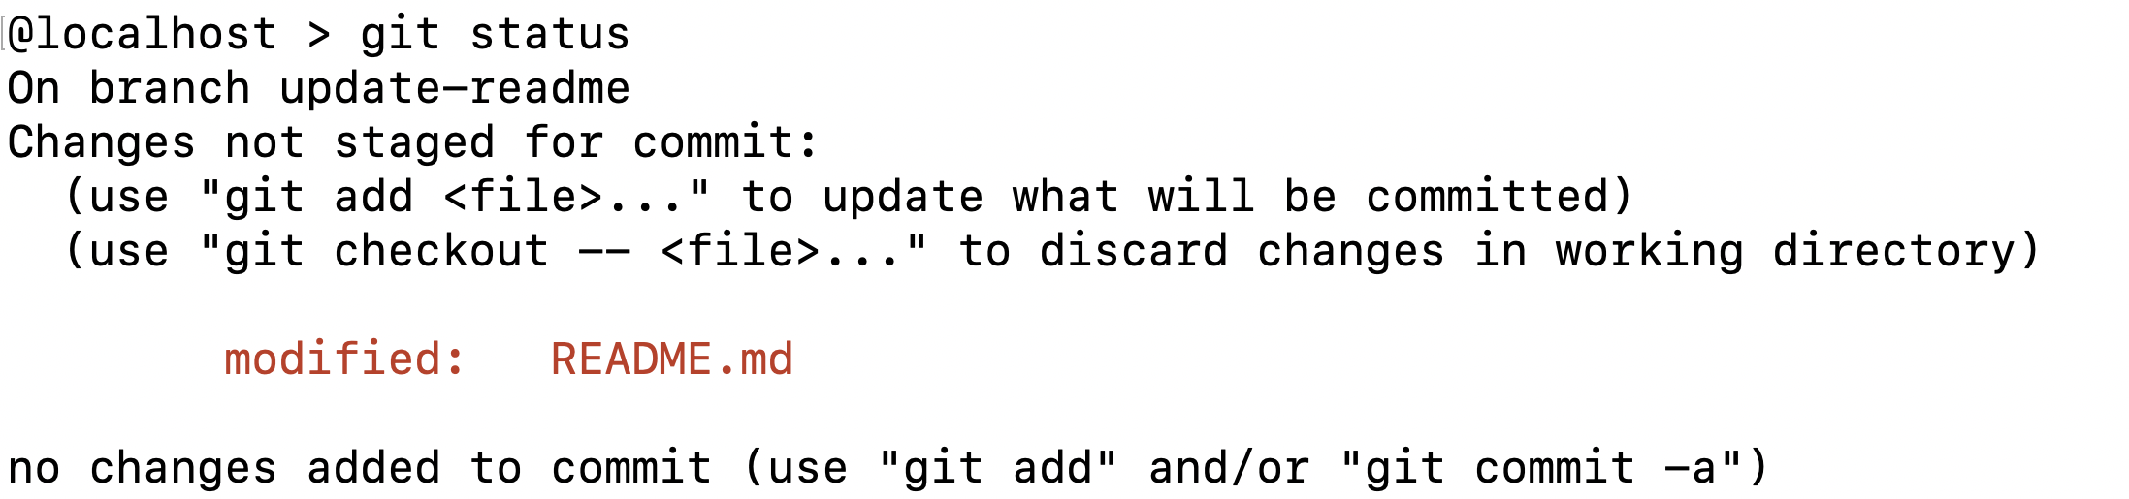
Let's make a change!
Return to your command line. Type the first command below. You should see output like this.
The output tells us that we have modified the README.md file. At the bottom, it tells us that we have not added any changes to commit. Let's do that now!

Slide 71
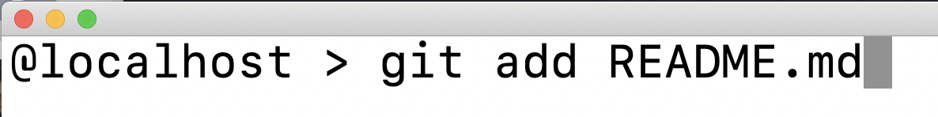
Let's make a change!
Type the command below. This command gets your changes ready to be committed.

Slide 72
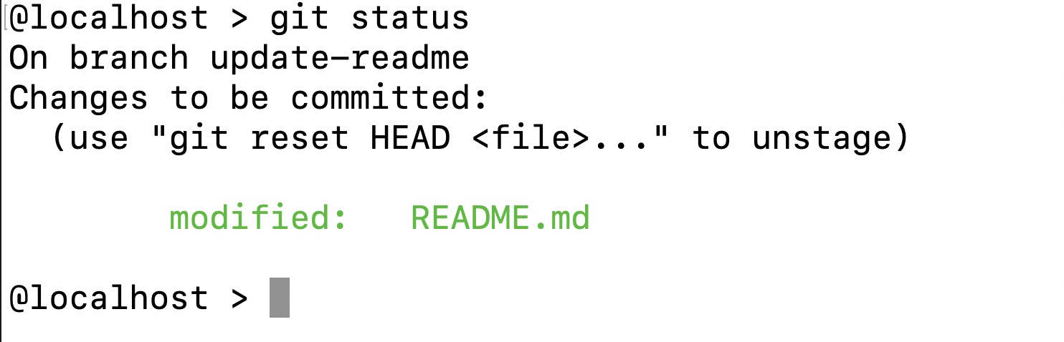
Let's make a change!
If you enter git status again, you will see that now the changes you made to README.md are ready to be committed!

Slide 73
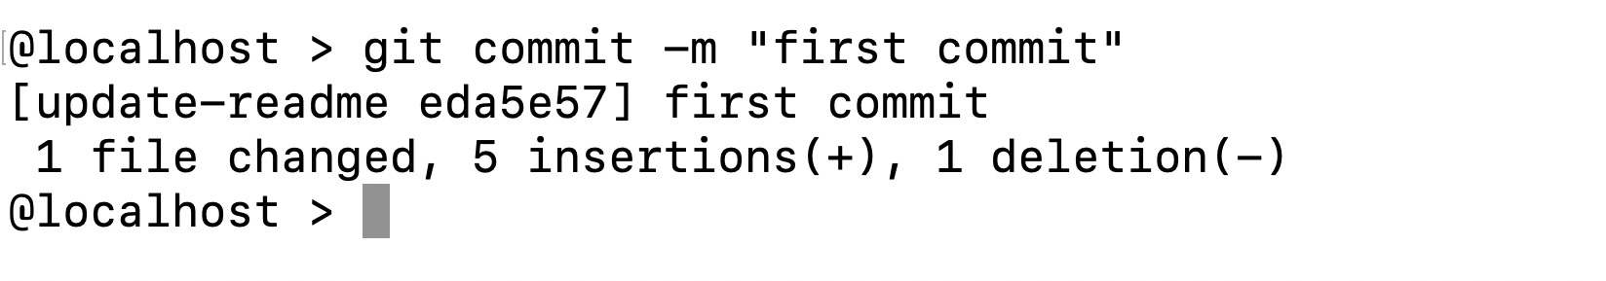
Let's make a change!
When you commit changes, you will include a commit message. This message should be descriptive of your changes. It's also a standard practice for your first commit to be "first commit."

Slide 74
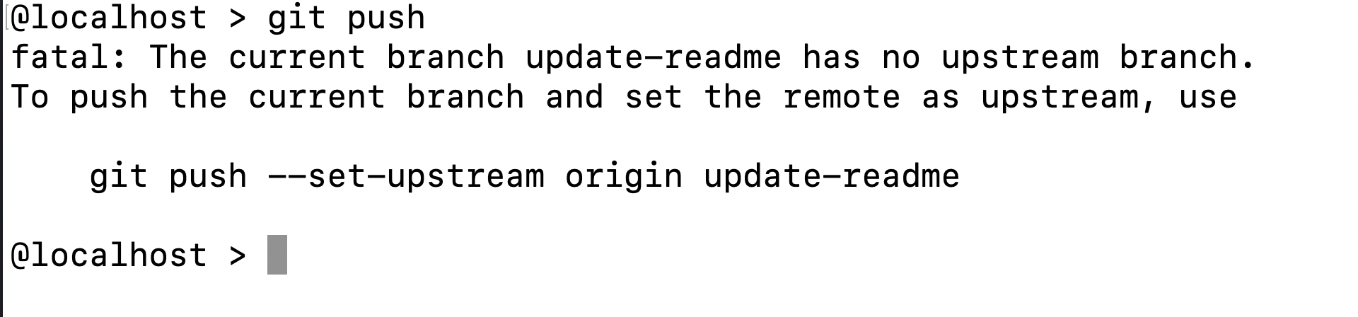
Let's make a change!
Now for a cool GitHub trick. We want to push the changes that we have committed up to GitHub. Type git push. Git will tell you the correct command! Copy and paste the command to add your local branch to GitHub and commit your changes.

Slide 75
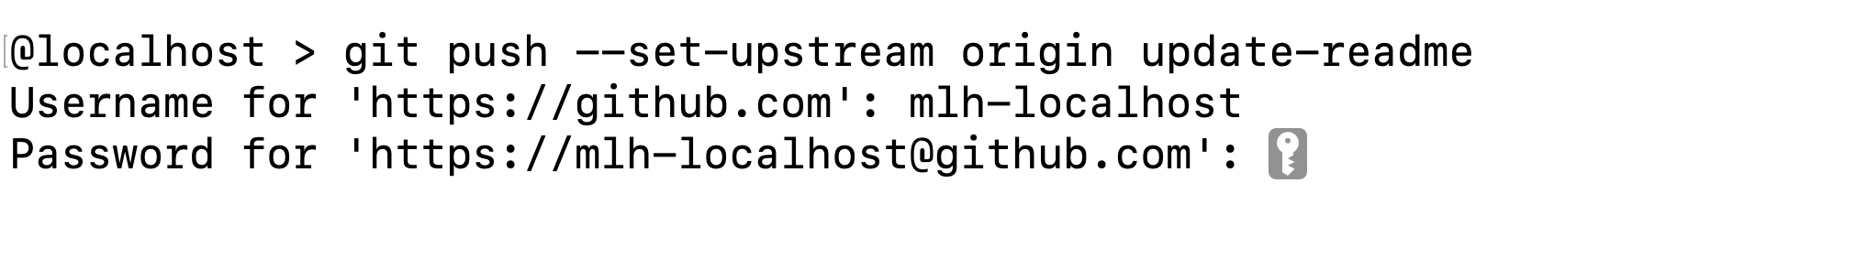
Let's make a change!
You'll need to enter your GitHub username and password. Note: When typing your password, you won't see anything.

Slide 76

Let's make a change!
You will see this output. Now you can create a pull request in the browser like you did before by going to the URL provided.
Notes:
If you use the suggested URL, you can skip the next slide.

Slide 77

Let's make a change!
Select Compare & pull request.

Slide 78

Let's make a change!
Name your pull request appropriately, then select Create Pull Request.

Slide 79

Let's make a change!
Finally, because you own the repo, you'll be able to merge your own pull request.

Slide 80

Let's make a change!
Now you want to make sure that your local master branch matches the master branch on GitHub. Return to your terminal and type the command below.

Slide 81
Let's make a change!
Finally, pull the changes on master down to your local repo with the command below.

Slide 82

Let's make a change!
Now you should be able to see your changes in the browser!

Slide 84
Let's recap quickly...
Git is a version control system allowing multiple people to collaborate
1
GitHub adds features to Git and provides a web interface
2
3
Command-line Git lets you propose changes without the web interface

Slide 85
What did you learn today?
We created a fun quiz to test your knowledge and see what you learned from this workshop.
http://mlhlocal.host/quiz

Slide 87
Keep Learning: Practice Problems for Later
Extra Practice Problem 1:
Configure Git with credentials so you don’t have to enter your password when pushing code.
Extra Practice Problem 2:
Use git stash to move changes between branches.
Notes:
What to Say:
Read the slide.
What to Do:
Encourage participants to try these problems on their own.

Slide 88

Learning shouldn't stop when the workshop ends...
Check your email for access to:
These workshop slides
Practice problems to keep learning
Deeper dives into key topics
Instructions to join the community
More opportunities from MLH!
Notes:
What to Say:
What to Do:

Slide 89
v.0.0.1

